Slide 1


2026 TRANSPORTATION TECHNOLOGY TOURNAMENT
Where student teams work with public agencies to solve real-world transportation problems utilizing ITS solutions and approaches.

Slide 2








JD Schneeberger
ITS JPO
Program Manager
Hoamy Tran
USDOT Volpe Center
Community Planner
Adam Hopps
NOCoE
Technical Services
Sara Davidson
USDOT Volpe Center
Technology and Transportation Specialist
Nick Ramfos
NOCoE
Director

Slide 3
Agenda
Welcome
Team Information Requests
Systems Engineering and the Concept of Operations (ConOps)
Developing the Solutions Document
Resources and Tips for Success
Questions?
Notes:
Training objectives
Help students:
Understand the basic systems engineering “V” at a high level
Learn what a ConOps is and why it matters
Map their idea into a ConOps-like structure (users, needs, operational scenarios)

Slide 4
Team Information Requests
Tournament Documents:
If your team has not yet submitted these documents, please respond ASAP.
Contact Adam Hopps AHopps@transportationops.org
Statement of team dynamics
Resumes
Headshots
Signed media release forms
An initial draft of your problem statement

Slide 5
Systems Engineering Process and the Concept of Operations (ConOps)

Slide 6

Learning Objectives
Learn the purpose and elements of the systems engineering process
Understand the “V” model approach at a high level
Outline the key components of a Concept of Operations (ConOps) and the questions it aims to answer
Map your idea into a ConOps-like structure (users, needs, operations)

Slide 7
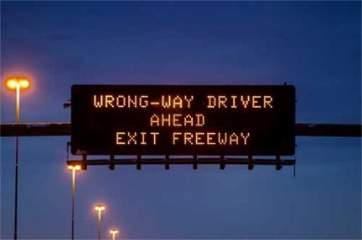

Key Definitions in Systems Engineering
System
System Engineering
A system is a combination of interacting elements organized to achieve one or more stated purposes.
Systems engineering is an integrative approach to enable the successful realization, use, and retirement of engineered systems, using systems principles and concepts, supported by scientific, technological, and management methods.
Source: Arizona Department of Transportation
Source: iStock.com/Iconic Prototype
Notes:
Key Message: what do we mean by system and systems engineering? This slide defines the terms “system” and “systems engineering.”
Timing: 2 minutes
Facilitation Guidance: Define systems and systems engineering, explaining where these definitions come from, including the International Council on Systems Engineering (INCOSE) and supplemented by the International Organization for Standardization (ISO), International Electrotechnical Commission (IEC), and Institute of Electrical and Electronics Engineers (IEEE).
Tell: We’ve identified a transportation problem, but how do we know that we are implementing the right solution? The answer is by following the systems engineering process. Before we get into the steps in the systems engineering process, we’ll explore some important terms and concepts, starting with what we mean by a “system.”
Tell: A system is, “a combination of interacting elements organized to achieve one or more stated purposes” (INCOSE and supplemented by ISO, IEC, and IEEE). This general definition covers many things including household appliances, weapons systems, even the solar system. A system needs elements that interact and a stated purpose for each element. Without understanding the purpose, defining what a project must build becomes impossible. But with the purpose defined, those parts and how they are integrated can be measured at every step of procurement from preliminary design to operation.
INCOSE, ISO, IEC, and IEEE are organizations involved in establishing standards and promoting practices in systems engineering, software engineering, and related fields.
Tell: Defining the boundaries of a system is critical because different participants may have different visions of what a system is. Consider the wrong-way driving scenario again. One component of a wrong-way driving mitigation system may involve use of a dynamic message sign, or DMS. To the DMS manufacturer, the DMS itself may be the entire system. However, for a public agency, that DMS may be just one piece of a larger ecosystem, just one component in providing the wrong-way driving (WWD) solution. Systems have input and output flows, representing exchanges of information with their surroundings.
Tell: Systems engineering, or SE, is a transdisciplinary and integrative approach to enable the successful realization, use, and retirement of engineered systems, using systems principles and concepts, and scientific, technological, and management methods. Systems engineering focuses on the total operation of a system.
Background Information: Acronyms stand for:
INCOSE = International Council on Systems Engineering
ISO = International Organization for Standardization
IEC = International Electrotechnical Commission
IEEE = Institute of Electrical and Electronics Engineers
Content sources:
https://ops.fhwa.dot.gov/int_its_deployment/sys_eng.htm
https://ops.fhwa.dot.gov/seits/sections/intro/1.html
https://ops.fhwa.dot.gov/seits/sections/intro/2.html
https://www.incose.org/about-systems-engineering/system-and-se-definitions/systems-engineering-definition
Image sources:
Image (left): Dynamic message sign (DMS) with the message: “Wrong-way driver ahead, exit freeway.”
Source: https://azdot.gov/adot-blog/drive-thru-small-talk-reinforces-mission-make-roads-safer
Image (right): Process of solving complicated, difficult problem. People unravel chaos and line multiple knots of wire to simplify.
Source: iStock (https://www.istockphoto.com/vector/process-solving-of-complicated-problem-simplicity-in-psychotherapy-of-tiny-people-gm2152819970-573796148)

Slide 8
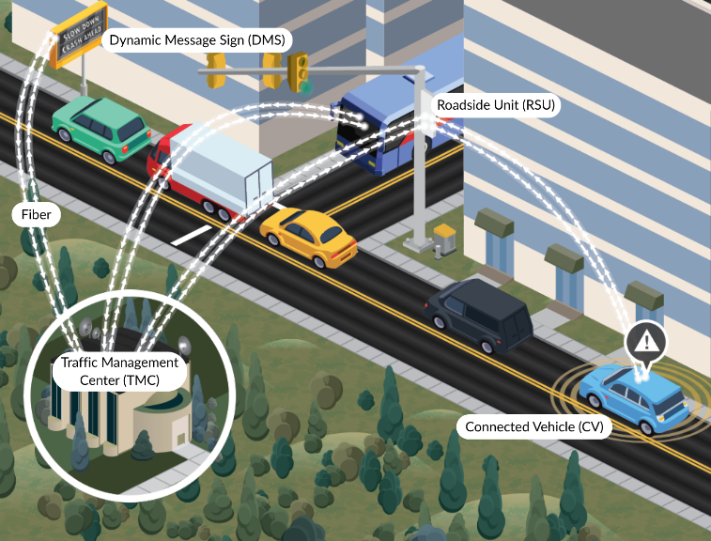
Systems Engineering Considers
Dynamic Message Sign (DMS)
Stakeholders and users
Factors internal and external to the system
Interactions with other systems and the environment
User needs from conception to retirement of a system
Multidisciplinary aspects
Competing needs and constraints
Roadside Unit (RSU)
Fiber
Transportation Management Center (TMC)
Connected Vehicle (CV)
Source: USDOT
Notes:
Key Message: Systems engineering focuses on the system as a whole and not just on the individual parts. View the system from the stakeholder points of view
Start at the finish line
Address risks as early as possible
Push technology choices to the last possible moment
Understand the organization
Timing: 2 minutes
Facilitation Guidance: Explain how systems engineering focuses on the total operation of a system by mentioning the various points of consideration. Then provide an example of a system using traveler information.
Tell: Systems engineering focuses on taking a holistic view of how it functions and evolves over time. It begins with understanding the needs and requirements of stakeholders and users, or those who interact with, operate, and maintain the system. Both internal and external factors must be considered, including how the system and its components behave, as well as the external rules, regulations, and constraints within which it must operate. Effective systems engineering also examines how the system interacts with other systems through data exchanges and accounts for the surrounding environment, such as weather conditions or roadway design. A system’s behavior must be aligned with user needs throughout its entire lifecycle, ensuring it delivers timely, actionable information. Because these systems often span multiple technical domains, systems engineering requires collaboration across disciplines such as electrical, mechanical, and software engineering. Finally, the process must balance competing needs and constraints; for example, enhancing safety without significantly reducing traffic flow or efficiency.
Tell: Consider an example. When providing road users with traveler information, a number of different ITS devices may be used. The graphic on the slide provides one example. In this example, an operator at a Transportation Management Center (TMC) is monitoring conditions to detect delays due to crashes. Information from the TMC is being fed to a DMS warning motorists to slow down due to a crash ahead. This information is also being fed into the Automatic Vehicle Location (AVL) system being used by the bus to calculate the arrival time at the next stop. Information from the TMC is also shared with the roadside unit, or RSU, to directly pass on to connected vehicles in the immediate area.
Ask: Think about it. Is the system the DMS? The sensors? The communications systems? Or each component?
Answer: The answer is that it depends, but everything needs to work together!
Tell: In the case of the traveler information system, the devices all function together as parts of a larger system designed to inform motorists and travelers about roadway conditions, traffic speeds, or delays. It can also be applied to a team of people working together. While each person may have their individual job responsibilities, the compilation of their work constitutes a wholistic solution.
Content sources:
https://ops.fhwa.dot.gov/int_its_deployment/sys_eng.htm
https://ops.fhwa.dot.gov/seits/sections/intro/1.html
https://ops.fhwa.dot.gov/seits/sections/intro/2.html
Image source:
Image: Traveler information system at an intersection.
Source: USDOT

Slide 9
What are the Principles and Benefits of Systems Engineering?
Principles
Benefits
View the system from the stakeholder points of view
Start at the finish line
Address risks as early as possible
Push technology choices to the last possible moment
Understand the organization
Leads to deployment of comprehensive, quality systems
Provides a systematic and logical approach for complex problems
Supports a needs- and requirements-based response
Brings a variety of stakeholders together for multiple perspectives
Notes:
SEP establishes a common language that leads to better understanding of everyone’s role and a better final product. Systems engineering mitigates the risk of technology-based projects not meeting the needs of their users.
Tell: Some of the principles of systems engineering are:
View the system from the stakeholder points of view means walking in the shoes of the stakeholders, with more emphasis on the system’s users and owner(s). Key processes for this principle include needs assessment, user need elicitation, developing a Concept of Operations, and, especially, user and all stakeholder involvement.
Start at the finish line defines the expectations for the system and the way the system is going to operate. The details might change but the key concepts and ideas on what the system should do to meet specific user needs should remain consistent. Key processes for this principle include Concept of Operations and Validation Plan.
Address risks as early as possible when the cost impacts to addressing those risks are the lowest. Key processes for this principle include risk management, requirements, and stakeholder involvement.
Push technology choices to the last possible moment. Define what is to be done before defining how it is to be done.
Understand the organization of the system’s owner, stakeholders, and development team.
Tell: Systems engineering is a process that leads to the development and deployment of comprehensive, quality systems. It provides a systematic and logical way to break down a large, complex problem or challenge that may not have a straightforward solution. Following the process helps you respond to the stated needs and requirements, instead of the system dictating the needs and requirements. It also naturally brings a variety of important stakeholders together, which helps you get multiple expert perspectives on a complex system. It also reduces the risk of schedule and cost overruns and increases the likelihood that the implementation will meet the user's needs.
Other benefits include:
Better system documentation
Higher level of user engagement
System functionality that meets user needs
Potential for shorter project cycles
Systems that can evolve with a minimum of redesign and cost
Higher level of system reuse
More predictable outcomes from projects
Content source:
https://ops.fhwa.dot.gov/seits/sections/intro/5.html

Slide 10
Systems Engineering Process V (“Vee”) Model
Planning, Designing, and Documenting
System Development
Planning Process
Project Planning
Operations and Maintenance
Retirement or Replacement
ConOps
Validation
Testing
Requirements
Verification
Testing
Design and Implementation
Notes:
SE approach defines project requirements before technology choices are made and the system is implemented. This slide explains the steps and deliverables associated with the systems engineering approach. The systems engineering approach, represented by the Vee model, provides a step-by-step process for ensuring the implementation of a comprehensive, quality ITS solution. Each phase of the Vee diagram has associated steps, and each step has associated deliverables.
In the V diagram as shown on the screen, there is a symmetry between the left and right sides of the model. The system definition that is generated on the left is ultimately used to verify and validate the system on the right. On the left side of the V, the system definition progresses from a general user view of the system to a detailed specification of the system design. As development progresses, a series of documented baselines support the steps that follow. For example, a concept of operations support system requirements development. Simpler systems don't require as much decomposition but still need to support the documented needs and requirements.
The development of your solutions document for this tournament begins at the planning process
block in the top left corner and encompasses the left side of the V model or the Planning, Designing,
and Documenting elements.
--------------
Tell: The Vee model is a representation of the systems engineering lifecycle for a project. Let’s consider the role and purpose of the steps in the Vee.
Tell: Before establishing the needs and as part of the planning process:
Link a project to regional vision, operational plans.
Develop a Project Management Plan and Systems Engineering Management Plan.
Tell: During the Concept of Operations, or ConOps, phase:
Define the problem. Defining the problem through the development of a problem statement is critical to eliciting meaningful user needs.
Capture user needs including user concerns, goals, and objectives, and specify what the system/solution/strategy is supposed to do.
Develop ConOps.
Tell: During the requirements phase:
Define and/or refine requirements.
Develop System Requirements and Design Specifications.
Tell: During the design and implementation phase:
Design a solution to meet the requirements.
Develop the Integration Plan.
Tell: During the verification testing phase:
Implement the system, test the system, verify the system against the requirements, and accept the system.
Develop Verification Documents and the Deployment Plan.
Tell: During the validation testing phase:
Validate the system meets the needs you established during the needs phase, operate the system, and maintain the system.
Develop Validation Documents and an Operations and Maintenance Plan.
------
Ask: Why do you think the Vee diagram is shaped like a “v”?
Answers: This is to visually represent the relationship between the developmental phases on the left side and the corresponding testing and validation phases on the right side, as indicated with the dashed arrows in the middle of the Vee. These arrows indicate that the verification testing is against the requirements, and the validation testing is ensuring the needs are being met by the final system.
Background Information: The Vee model illustrated on this slide is a representation of the systems engineering lifecycle for a project. It is a sequential model outlining the progression of plans, specifications, and products through configuration management. With the understanding that there are years’ worth of planning efforts that come before applying systems engineering to transportation, or more specifically ITS projects, and that there are operations and maintenance as well as retirement and replacement efforts after a system is deployed, this module focuses on the “v” aspects of the systems engineering approach for project development. The sequential nature of the Vee Model allows for a clear progression of activities, from defining needs and requirements to verification and validation, ensuring the system meets its intended purpose and requirements. Also note how the initial steps and later steps support each other.
Content source:
https://ops.fhwa.dot.gov/seits/sections/intro/3.html
https://ops.fhwa.dot.gov/seits/sections/intro/6.html
Image source:
Image: Diagram of the V-Model systems engineering process showing lifecycle stages from left to right. On the left descending side: Planning Process, Project Planning, ConOps (Concept of Operations), Requirements, and Design and Implementation. On the right ascending side: Verification Testing, Validation Testing, Operations and Maintenance, and Retirement or Replacement. Blue dashed arrows connect ConOps to Validation Testing, and Requirements to Verification Testing, illustrating how earlier planning stages link to later testing stages.
Source: USDOT

Slide 11
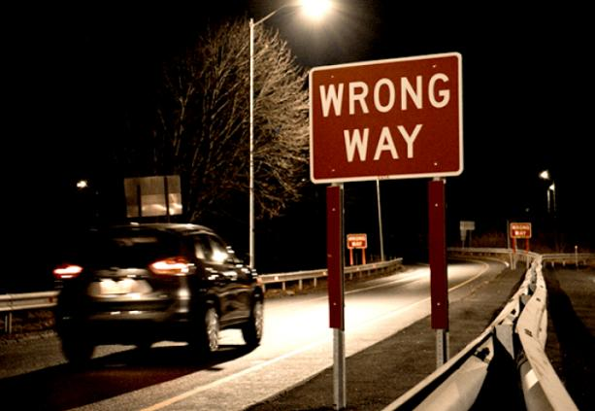
Transportation Challenge: Wrong-way Driving Example
Occurs when a vehicle is driven against the direction of traffic
Caused by distraction, impairment, or insufficient or unclear road markings or signage
Particularly dangerous on freeways where higher speeds may produce more severe head-on crashes
Serious and persistent safety challenge on the interstate in this community
Source: Connecticut Department of Transportation (CTDOT)
Notes:
Key Message: This slide introduces an example transportation issue that we will use throughout the module to explore the systems engineering process.
Facilitation Guidance: Instead of jumping straight into the systems engineering definition, process, or Vee model, set the stage for this module by providing some context. Introduce the scenario by explaining what wrong-way driving is and the risks it poses. Then, explain the scenario.
Tell: Wrong-way driving occurs when a vehicle is driven against the direction of traffic. Causes of wrong-way driving include distraction, impairment, and insufficient or unclear road markings or signage. Wrong-way driving is especially dangerous on freeways, where higher speeds may produce more severe head-on crashes.
Tell: Wrong-way driving presents a serious and persistent safety challenge. Although relatively rare, these incidents are disproportionately severe—more than half result in injury or death, with most occurring at night and on weekends (approximately 71% of wrong-way driving crashes on freeways occurred during dark or nighttime conditions and about 58% of freeway wrong-way driving crashes occurred on weekends). Impairment is a common contributing factor.
To address this risk, traditional countermeasures such as enhanced static signage and pavement markings have already been implemented at high-risk locations. Despite these efforts, wrong-way entries continue to occur.

Slide 12
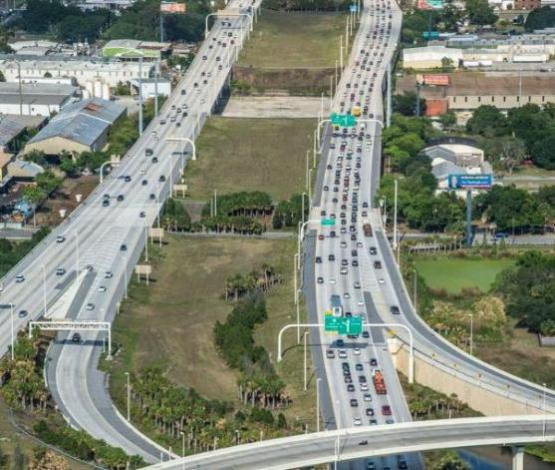
Problem Statement Brainstorm: Wrong-way Driving Example
Despite enhanced static signage and pavement markings at high-risk locations, wrong-way entries continue to occur.
A State DOT wants to implement a solution to mitigate and prevent wrong-way driving on the interstate.
Solution needs to more clearly warn drivers that they are entering the freeway in the wrong direction, detect wrong-way driving, inform drivers on the freeway, and quickly dispatch emergency response services.
Source: FDOT
Notes:
Additional considerations for this example; how can ITS solutions be applied to address this safety issue?
Tell: To address the wrong-way driving risk, traditional countermeasures such as enhanced static signage and pavement markings have already been implemented at high-risk locations. Despite these efforts, wrong-way entries continue to occur.
Tell: Therefore, the DOT would like to consider additional countermeasures. The solution needs to more clearly warn drivers that entering the freeway at the off-ramp is the wrong direction, detect wrong-way driving and inform drivers on the freeway that another vehicle is traveling in the wrong direction, and quickly dispatch emergency response services to escort the wrong-way driving vehicle safely off the freeway.
Tell: In systems engineering, the problem definition stage is crucial for identifying and describing the problem the system aims to address, setting the overall direction for the system. A problem statement answers three questions: What is the problem or need? Who has the problem or need? Why is it important to solve? When developing an initial problem statement, consider the format of who needs(s) what because why.
Ask: What is the problem or need?
Answer: The problem is wrong-way drivers entering the freeway.
Answer: The need is a bit multi-faceted. First, the need is to reduce or eliminate drivers entering the freeway the wrong direction as much as possible. Then, if the driver does enter the freeway the wrong direction, the need is to warn other drivers of the wrong-way driver so that they are aware and can avoid them and dispatch emergency personnel immediately to stop the wrong-way driver.
Ask: Who has the need? In other words, who is directly impacted by wrong-way driving in this scenario?
Answer: Drivers entering the freeway the wrong direction and drivers on the freeway driving in the direction where a wrong-way driver has entered the freeway.
Ask: Why is this happening?
Tell: Putting together all of the pieces of the who, what, and why, participants may come up with a statement such as the following:
The interstate experiences wrong-way driving incidents that endanger the lives of drivers on the freeway. DOT would like to develop and implement an approach to reduce the number of wrong-way drivers. DOT would also like to improve the safety and operations of the roadway by providing early detection of wrong-way drivers, issuing warnings to wrong-way drivers and upstream motorists, and dispatching emergency response services to escort the wrong-way driving vehicle safely off the freeway.
Background Information: Consider another example of a problem statement, in this case for a truck parking project.
Problem statement: State X has an interstate freeway that is a major north south corridor for truck traffic. The corridor has several public and privately operated rest area facilities that are often congested and over capacity as trucks are required to limit hours of operation. The interstate is severely congested approaching urban areas, limiting the distances trucks can travel along the corridor due to the constrained hours of service. Truck drivers commonly complain about the difficulty of obtaining information on truck parking availability in a timely fashion to improve their operations and find available parking facilities during their off hours. State X would like to enhance highway safety by providing timely and reliable truck parking, provide sustainable and scalable truck distribution to available space, and project a secure solution that protects user privacy and data.
Image source:
Image: I-4 in central Florida.
Image source: FDOT (https://www.tampabaynext.com/projects/i-4-corridor/)

Slide 13

What is the Concept of Operations (ConOps)?
Systems Engineering Approach
Planning Process
Project Planning
Operations and Maintenance
Retirement or Replacement
Associated Deliverables
ConOps
Validation
Testing
Concept of Operations (ConOps)
Requirements
Verification
Testing
Design and Implementation
Source: USDOT
Notes:
Key Message: The ConOps is a stakeholder-oriented description of the system that is being developed. The purpose of the ConOps is to clearly convey a high-level view of the system to be developed that each stakeholder who has a stake in the system (e.g., owner, operator, maintainer, developer, management, and in some cases the end user) can understand.
Timing: 2 minutes
Facilitation Guidance: Explain how the ConOps acts as a bridge between the user needs (transportation challenge or problem) and the system requirements.
Tell: A problem statement and user needs are critical inputs into a Concept of Operations or ConOps document. The ConOps is a non-technical, stakeholder-oriented description of the system being developed and explains how it will be used. It presents each of the multiple views of the system corresponding to the various stakeholders, reflecting the various stakeholder’s viewpoints. These stakeholders include operators, owners, developers, maintenance, management, and in some cases end users.
Tell: The ConOps provides a bridge between the vague needs that motivated the project and the specific technical requirements necessary to build and implement the system. The documentation of the ConOps can be easily reviewed by the stakeholders to get their agreement on the system description, operations, and maintenance. It also provides the basis for validating the system being built.
Tell: The ConOps includes:
High-level identification of user needs and system capabilities in terms that all project stakeholders can understand.
Shared understanding by stakeholders on the who, what, why, where, and how of the system.
Agreement on key performance measures and a basic plan for how the system will be validated at the end of project development.
Content source:
https://ops.fhwa.dot.gov/seits/sections/section3/3_3_5.html
https://ops.fhwa.dot.gov/seits/sections/intro/6.html
Image source:
Image: Diagram of the V-Model systems engineering process showing lifecycle stages from left to right. On the left descending side: Planning Process, Project Planning, ConOps (Concept of Operations), Requirements, and Design & Implementation. On the right ascending side: Verification Testing, Validation Testing, Operations and Maintenance, and Retirement/Replacement. Blue dashed arrows connect ConOps to Validation Testing, and Requirements to Verification Testing, illustrating how earlier planning stages link to later testing stages. ConOps is highlighted.
Source: USDOT

Slide 14
What is Included in the Concept of Operations (ConOps)?
A ConOps describes the proposed system around the idea of the individuals who will use that system. It includes:
Goals and objectives of the system
Strategies, tactics, policies, and constraints affecting the system
Organizations, activities, and interactions among participants and stakeholders
Clear statement of responsibilities and authorities delegated
Specific operational processes for fielding the system
Processes for initiating, developing, maintaining, and retiring the system
Check the ConOps Template in your TTT Module 2 Resources List

Slide 15

What Goes in a Concept of Operations (ConOps)?
Template from the Institute of Electrical and Electronics Engineers [IEEE] Standard 1362-1998
Reflects various stakeholder’s viewpoints
Description of how the system will be used
Scope
Referenced Documents
The Current System or Situation
Justification for and Nature of Changes
Concepts for the Proposed System
Operational Scenarios
Summary of Impacts
Analysis of Proposed System
Non-technical
Source: iStock.com/VectorMine
Bridge between vague needs and technical requirements
Notes:
Key Message: This slide describes the purpose of the ConOps and what information goes in it.
Timing: 1 minute
Facilitation Guidance: Explain the ConOps general structure and what information it contains.
Tell: Given what the ConOps is, common templates are often used to organize the information that needs to go into it. One such template is that from the Institute of Electrical and Electronics Engineers or “I”-triple “E”. However, depending on the project and system, some sections may be optional and other additional sections or appendices may be utilized. The sections of the “I”-triple “E” standard 1362-1998 template include:
The Scope section is where to provide a brief overview of the system to be built, including its high-level objectives and description.
The Referenced Documents section is where to list any supporting documentation and other resources that are useful in understanding the operations of the system, such as any strategic plans that drive the goals of the system to be developed.
The Current System or Situation section is where background information, objectives, and scope of the current system or situation, how it is currently used, and its drawbacks and limitations, user classes and other involved personnel, and the support environment should be provided.
This information leads into the Justification for and Nature of Changes section, which is where to provide the reasons for the proposed development, general approach to improve the system with a description of the desired changes, priorities of the changes, and changes considered but not included.
Next is the Concepts for the Proposed System section, which is where to provide the background, objectives, and scope operational policies and constraints, description, modes of operation, user classes and other involved personnel, and the support environment for the proposed system.
This is followed by Operational Scenarios, which is the heart of the document and where use case descriptions of where the system will be used, including user interactions, action/event and information flows, and expected outcomes are described. The scenarios should aim to cover all normal conditions, stress conditions, failure events, maintenance, and exceptions.
The Summary of Impacts section is where potential positive and negative effects of the proposed system on operational, organizational, and other related aspects to stakeholders are communicated. Such documentation efforts allow for a shared understanding and ability to address concerns early in the process to be fostered.
Finally, the Analysis of Proposed System section is where a summary of the improvements, disadvantages and limitations, as well as alternatives and trade-offs considered are provided, including performance measures for assessing the system.
Content sources:
https://ops.fhwa.dot.gov/seits/sections/section3/3_3_5.html
https://ops.fhwa.dot.gov/seits/sections/section6/6_4.html
https://standards.ieee.org/ieee/1362/2047/
Image source:
Image: Illustration of three people interacting with oversized computer screen displaying digital documents and folders. One person climbs a ladder toward a floating document, another sits atop the monitor, and a third points to a large folder icon. Background includes abstract plants, clouds, and stars, suggesting digital organization and collaboration.
Source: iStock (https://www.istockphoto.com/vector/data-entry-jobs-with-information-writing-to-digital-files-tiny-person-concept-gm2076114885-564910807)

Slide 16
What Are User Needs? Why Are They Important?
Definition
Considerations
A user need is a high-level capability, service, or outcome that the stakeholder expects the system to be able to do. It is what the user or stakeholder wants or needs the system to do, without specifying how it should be done.
Expressed in plain language from the user’s perspective
Focused on desired outcomes, not technical solutions
User needs define the system requirements later in the SE process

Slide 17

Defining Needs from the Users’ Perspectives
Who – Who are the stakeholders involved with the system?
What – What are the elements and the high-level capabilities of the system?
Where – What is the geographic and physical extent of the system?
When – What is the sequence of activities that will be performed?
Why – What is the problem or opportunity addressed by the system?
How – How will the system be developed, operated, and maintained?
Notes:
Key Message: A good ConOps answers who, what, where, when, why, and how.
Timing: 2 minutes
Facilitation Guidance: Explain the questions that a ConOps answers.
Tell: A good ConOps answers the following questions:
Who – Who are the stakeholders involved with the system?
What – What are the elements and the high-level capabilities of the system?
Where – What is the geographic and physical extent of the system?
When – What is the sequence of activities that will be performed?
Why – What is the problem or opportunity addressed by the system?
How – How will the system be developed, operated, and maintained?
Tell: The ConOps also sets the foundation for system requirements. It provides an opportunity for identifying performance measures that define how success will be judged, ensuring the system is built to meet real-world operational needs.
Background: A ConOps helps the project team visualize the final system at the beginning of the project. Benefits of developing a ConOps include early stakeholder agreement on 1) system capabilities, 2) user needs, 3) roles and responsibilities, and 4) key performance measures and a basic plan for system validation as well as helps to manage stakeholder expectations (Federal Highway Administration [FHWA], The System Engineering Approach for Strengthening Mobility and Revolutionizing Transportation [SMART] Grant Recipients).

Slide 18
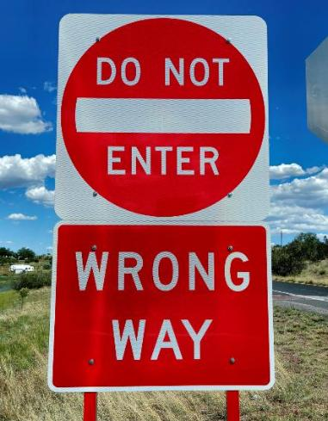
Building the ConOps: Wrong-way Driving Example
Questions to Consider When Developing the ConOps:
What details do we know about the transportation problem?
Who are the stakeholders involved?
What are some ways to alert drivers?
What has the Department of Transportation (DOT) implemented already? What are the limitations of these solutions?
What would a technology solution need to do to better mitigate the WWD problem?
What other information might you need to know to develop a solution for this problem?
What other questions would you ask to better understand the problem, needs, or desired solution?
Source: iStock.com/Michael Paul Lindsey II
Notes:
What details do we know about the transportation problem?
Who are the stakeholders involved?
What are some ways to alert drivers?
What has the Department of Transportation (DOT) implemented already? What are the limitations of these solutions?
What would a technology solution need to do to better mitigate the WWD problem?
What other information might you need to know to develop a solution for this problem?
In other words, what other questions would you ask to better understand the problem, needs, or desired solution?

Slide 19
Stakeholders
Federal, state, and local DOTs
City and regional planning agencies
Transportation and transit operators
Technology providers
Traveling public
Broader community
Notes:
Potential stakeholders who may be involved with the system. Think about how these groups may be impacted and what data they might have to inform your solutions document, or what role they might play in the planning and implementation of your ITS solution?
Traveling public includes locals and visitors attending the special event and surrounding activities, local residents not involved with the special event, and the traveling public on surrounding roadways

Slide 20
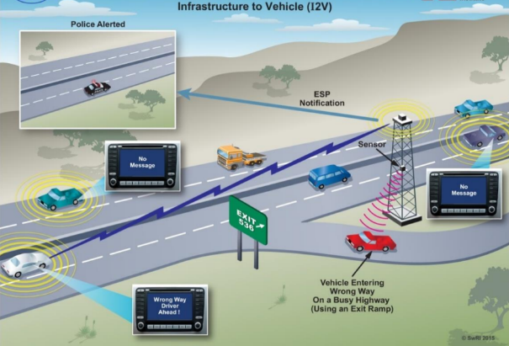
How Will the System Be Used?
An operational scenario is a detailed step-by-step description of how a system will operate in its intended environment in normal and abnormal conditions
It details interactions between the system and its environment and interactions between system components
They help understand the expected utilization of the future system in terms of actions
Source: Southwest Research Institute (SwRI)
Notes:
Key Message: This slide describes operational scenarios and how they are used to form and evaluate a system.
Timing: 2 minutes
Facilitation Guidance: Define and explain the purpose of an operational scenario with a WWD example.
Tell: Operational scenarios help explain how a system will be used by considering the interactions between the system and its environment as well as interactions between system components. Specifically, they are used to evaluate requirements and design of a system and then verify and validate a system’s functionality in both normal and abnormal conditions.
Tell: Consider an operational scenario related to wrong-way driving. The figure on the slide shows a scenario that uses different aspects of the system to detect a wrong-way driver, notify TMC personnel and law enforcement, and alert connected vehicles (CVs). In this scenario, a traditional WWD detection sensor and roadside equipment work together to quickly alert approaching vehicles by sending out a Roadside Safety Alert, or RSA. Law enforcement would be notified via TMC personnel; however, if the law enforcement vehicle is CV-equipped and within range of the roadside equipment, it would receive the alert along with other CVs.
Tell: The described operational scenario is a simplified example. To see how detailed operational scenarios can get in practice, please refer to the ConOps we will be using in the next activity.
Content source:
Systems Engineering Body of Knowledge (SEBoK) – Operational Scenario. https://sebokwiki.org/wiki/Operational_Scenario_(glossary)
Image source:
Image: Operational scenario for connected vehicle environment response to WWD.
Source: https://static.tti.tamu.edu/tti.tamu.edu/documents/0-6867-1.pdf

Slide 21
ConOps Sets the Stage for System Requirements: Wrong-way Driving Example
Example: Problem Statement
Example: User Needs
Example: System Requirements
Provide early detection of wrong-way drivers and issue warnings to wrong-way drivers and upstream motorists.
Alerts and signals that indicate when a wrong-way driver is approaching so drivers know when to pull over or exit the roadway.
The system shall notify drivers traveling in the correct direction of traffic of an approaching wrong-way driver with DMS messages.
Associated Deliverables
Planning Process
Project Planning
Operations and Maintenance
Retirement or Replacement
ConOps
Validation
Testing
System Requirements
Requirements
Verification
Testing
Design and Implementation
Notes:
Key Message: The ConOps sets a project up for the next parts of the systems engineering process, first of which is the development of system requirements.
Timing: 2 minutes
Facilitation Guidance: Explain that the ConOps feeds into the requirements and design. Describe what a system requirement is. Explain the example on the screen showing how you can go from a problem statement to defining user needs to developing a system requirement. Then ask participants to think about what performance measures/metrics they would collect to evaluate the system, show that needs were met, and that the system made an impact in addressing the challenge.
Tell: The ConOps feeds into the requirements and design. Requirements drive both the procurement and design processes. Requirements define the necessary functions and features of the system, guiding the development and operational elements. Requirements are specified at every level, from the overall system down to each component, ensuring a comprehensive understanding of what the system must do and how well it must perform.
Tell: If the problem is that we have wrong-way drivers endangering other drivers, we may want to provide early detection of wrong-way drivers and issue warnings to wrong-way drivers and upstream motorists. A user need could be a need for alerts and signals that indicate when a wrong-way driver is approaching so drivers know when to pull over or exit the roadway. If that is the need, a system requirement may be that the system shall notify drivers traveling in the correct direction of traffic of an approaching wrong-way driver using dynamic message systems (DMS) messages.
Tell: A clear statement of requirements provides:
A shared understanding of the problem to be solved by customer and developer;
A firm basis for managing project scope;
The connection between user needs and system design; and
The foundation for system verification/testing.
Tell: Looking at the Vee diagram, there is a direct relationship between requirements and verification testing. The requirements describe stakeholder needs and define those elements that require verification after the design and implementation phases of the systems engineering process.
Tell: The role of stakeholders in the development of requirements is critical. It is important to involve stakeholders in requirements development even though stakeholders may not have experience in writing requirements statements. However, they are the foremost experts concerning their own requirements. The requirements are the primary, formal communication from the system stakeholders to the system developer. The project will be successful only if the requirements adequately represent stakeholders' needs and are written so they will be interpreted correctly by the developer.
The ConOps and requirements set a project up for the next parts of the systems engineering process (NOT focus of today’s training but for reference includes design and implementation, verification and validation testing, operations and maintenance and System replacement /retirement.

Slide 22
Developing the Solutions Document

Slide 23

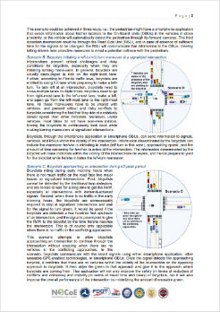
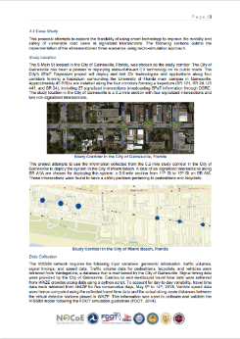
Developing Solutions Documents for the TTT
Your Solutions Document is a mini-Concept of Operations (ConOps)
10-15 pages of content (does not include a cover, table of contents, appendices, etc.)
Required Sections include:
Description of the Problem
Description of the Solution
Solution Architecture
Anticipated Impacts
Notes:
Concept of Operations: The purpose of the concept of operations (ConOps) step is to clearly convey a high-level view of the system to be developed that each stakeholder can understand.

Slide 24


1. Description of the Problem
Your problem statement:
Focus on a safety problem
Be specific to one problem
Be improved using technology
Be sure to include:
Where your project is located
Challenges in your study area
Data that backs up your problem
Stakeholders
Additional resources used
Source: Microsoft stock photos

Slide 25
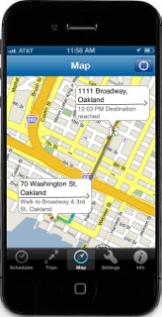

2. Description of the Solution
Your solution will be specific to the transportation safety problem you are trying to solve.
When describing your solution, think about including:
The goals and objectives of your solution
How your solution will help to address your problem
Who are the stakeholders involved and how your solution will be used by stakeholders
How your solution works with the existing environment
Supporting information to describe your solution
Source: 511SF web site
Source: iStockphoto.

Slide 26
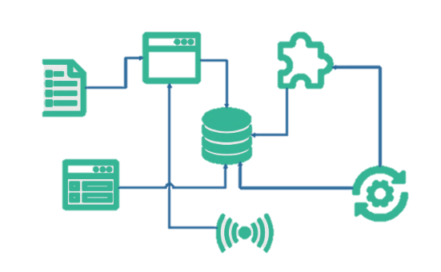
3. Solution Architecture
This topic will be covered in Training #3 on April 27
We will be asking for a physical and functional architecture:
Physical View depicts the transportation systems and the information exchanges between the physical objects of the ITS solution.
Functional Description provides a description of the Physical Objects.

Slide 27

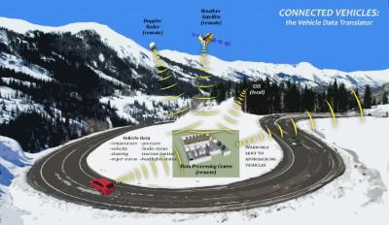
4. Anticipated Impacts
Describe the impact your solution will have on the broader community and the stakeholders involved.
Think about including how your solution:
Meets the goals and objectives laid out
Will improve transportation safety
Enhances the existing environment
Will impact various stakeholders
Example Michigan Solutions Document (here)

Slide 28
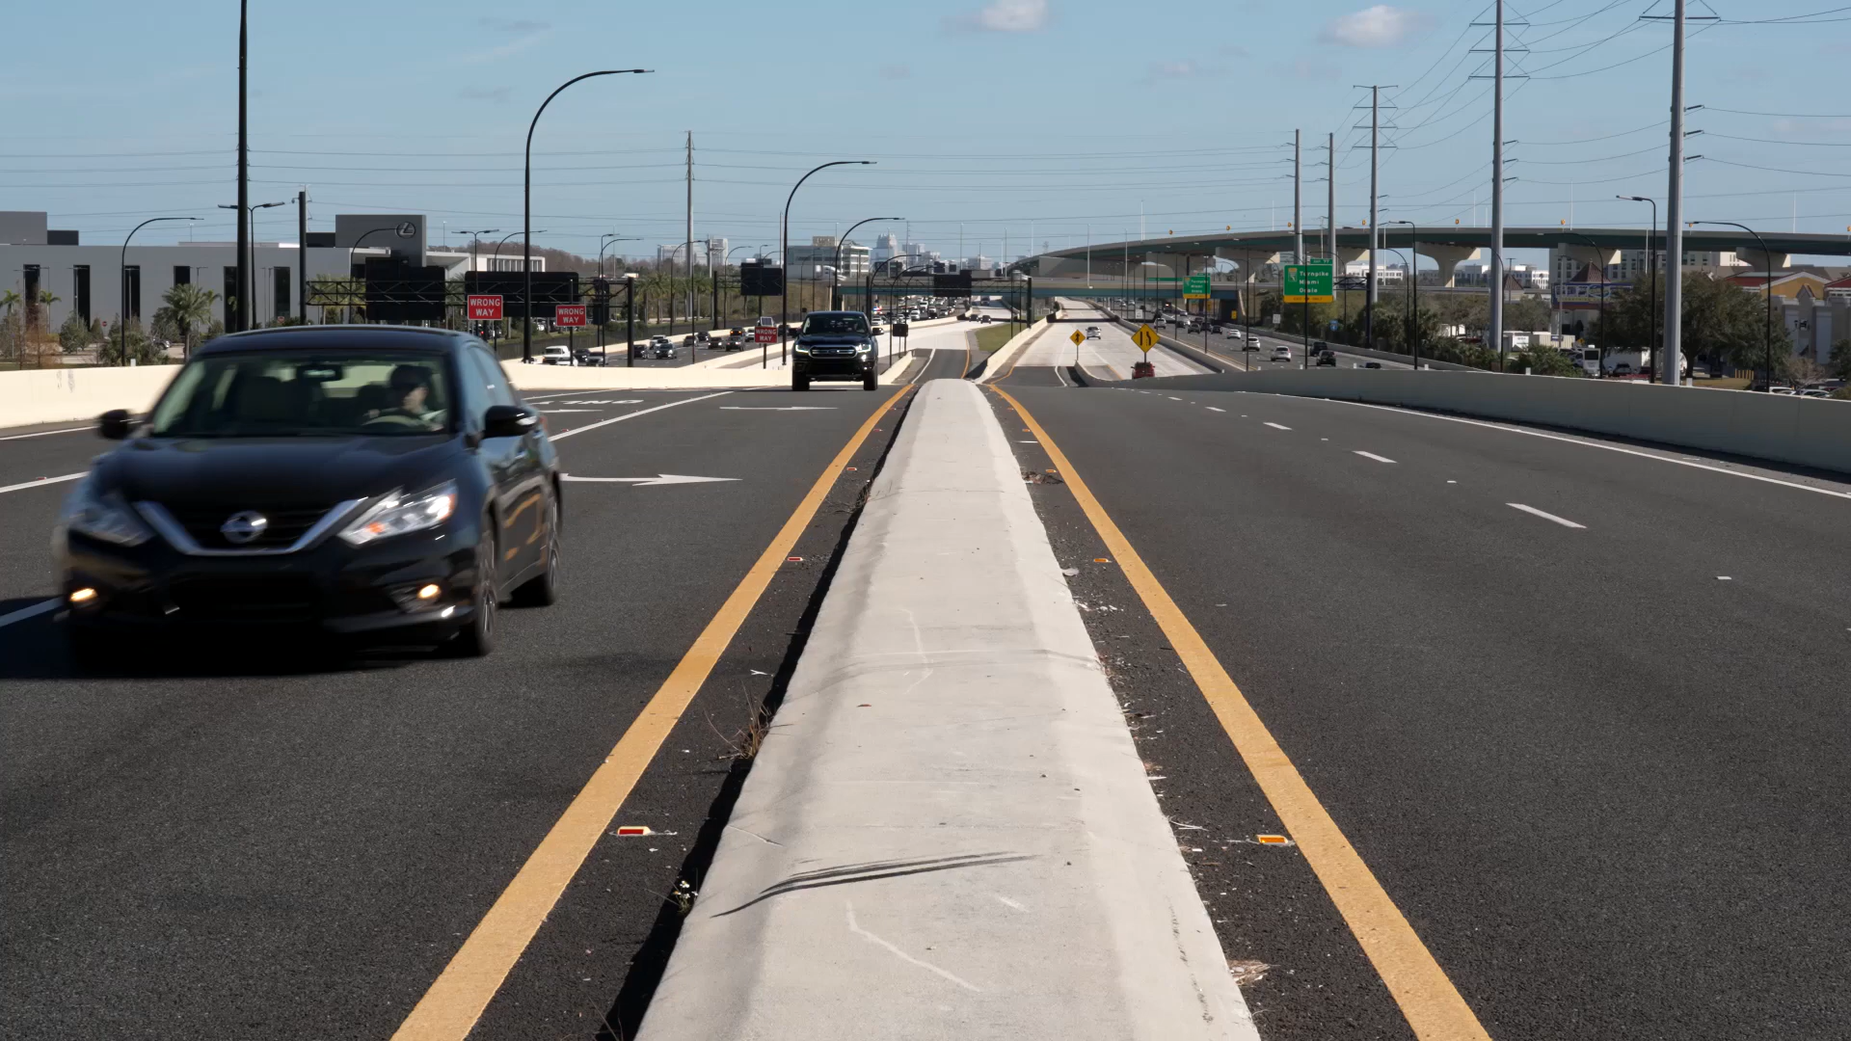
Wrong-way Vehicle Detection System Solution
Notes:
Key Message: This slide shows what a wrong-way driving solution looked like.
Timing: 3 minutes
Facilitation Guidance: Show the video.
Wrong-way Vehicle Detection System Solution: Signs, reflectors, and pavement markings are being added to off ramps. The detection system works by using sensors that detect drivers traveling the wrong direction, which activates lights on red “wrong-way” signs to catch the wrong-way driver’s attention and immediately sends an alert to the regional transportation management center and law enforcement. Dynamic message signs also display warnings to other drivers, notifying them that a wrong-way driver has been detected or reported. DOT also urges people who see a wrong-way driver not to panic, pay attention to signs, and pull over to the side of the road to call 911.
Video source:
https://www.youtube.com/watch?v=uh1mfrVkFCw

Slide 29
Resources and Tips for Success

Slide 30
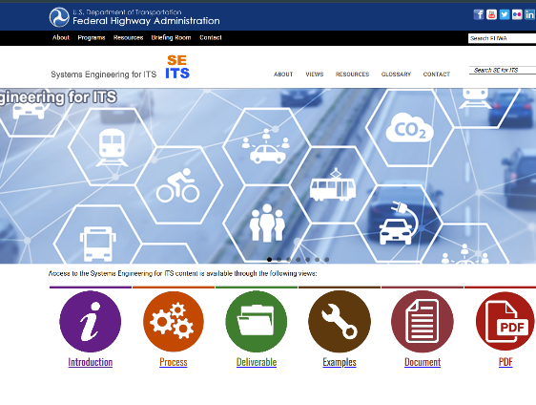
Resources Available to You
Systems Engineering for ITS: https://ops.fhwa.dot.gov/seits/
TTT Module 2 Resource List
1-on-1 Office Hours are available upon email request to help workshop your problem statement or solution document ideas
Contact Hoamy.Tran@dot.gov if your team is interested

Slide 31

Tips for Success
Reminder that you are writing a 10–15-page Solutions Document. You do not need to develop a prototype or model.
We are judging your problem and solution as a system – we’re looking at each section of the Solutions Document.
We are not judging the “results” of anything developed, but figures and images enhance your solution document.
Continuously engage with your Academic Advisor, Industry Mentor, and USDOT and NOCoE team for information and support.

Slide 32

2026 Schedule: Key Dates and Milestones
Status | Activity | Purpose | Dates
 | Sign Up Deadline | Last day to register a team for the tournament | February 2, 2026
 | Tournament Kickoff | Officially kick off the 2026 TTT and begin working on problem statements | February 9, 5pm ET
 | Training Module #1 | Introduction to ITS and the Safe System Approach | March 2, 5pm ET
 | Training Module #2 | Systems Engineering, ConOps, and Developing Solutions | March 30, 5pm ET
 | Training Module #3 | Architecture and Other Considerations for Solution Document Development | April 27, 5pm ET
 | Solution Documents Due | Final Deadline to submit Solution Documents | May 18, 2026
 | Finalists Present at ITE | Travel will be coordinated | July 20, 2026

Slide 33

Next Steps
If you haven’t already, connect with an industry professional who can serve as a mentor
Continue developing your problem statement
Begin drafting your ConOps sections (Problem, Solution, Operations) and iterate with mentors
Contact us if you need support
Next training is on April 27 at 5pm ET

Slide 34





Connect With Us
https://transportationops.org/transportation-technology-tournament
J.D. Schneeberger
ITS Joint Program Office (JPO)
ITS PCB Program Manager
John.Schneeberger@dot.gov
Nick Ramfos
NOCoE
Director
NRamfos@aashto.org
Adam Hopps
NOCoE
Technical Services and Communications
AHopps@transportationops.org
Hoamy Tran
USDOT Volpe Center
Community Planner
Hoamy.Tran@dot.gov

Slide 35
Questions?

